Slide 1

Cantilever beam
Politecnico di Torino – MSc Automotive Engineering
Numerical Modelling and Simulation – Part A – prof. Alessandro Scattina
Accademic year 2024/2025
Tommaso Massone

Slide 2
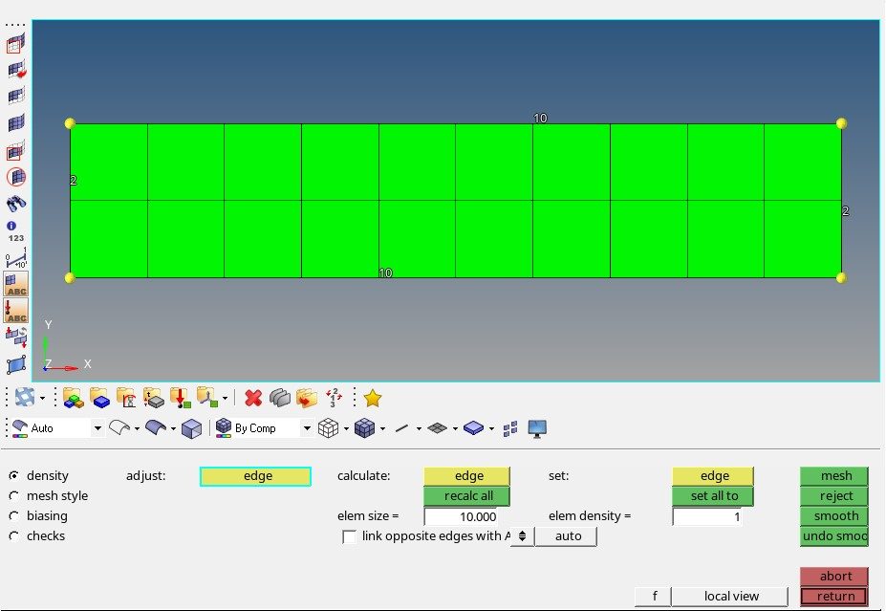
Creation of the models
Temporary node
Defined the nodes of the beam, the mesh can be created choosing the appropriate measure of the element
Temporary nodes need to be removed after the creation of the mesh; force, constraints and any type of boundary condition have to be directly applied to the mesh
Reducing the element size the mesh is more accurate: effects of this change can be seen in table 1

Slide 3
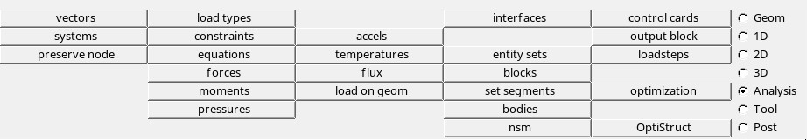
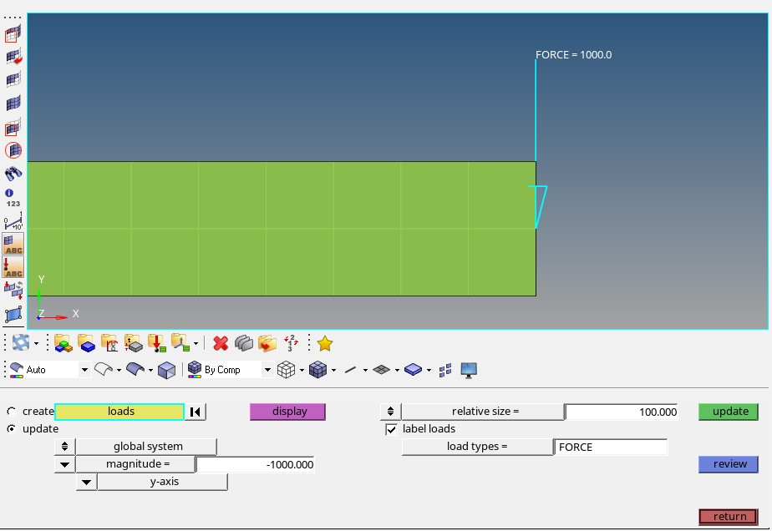
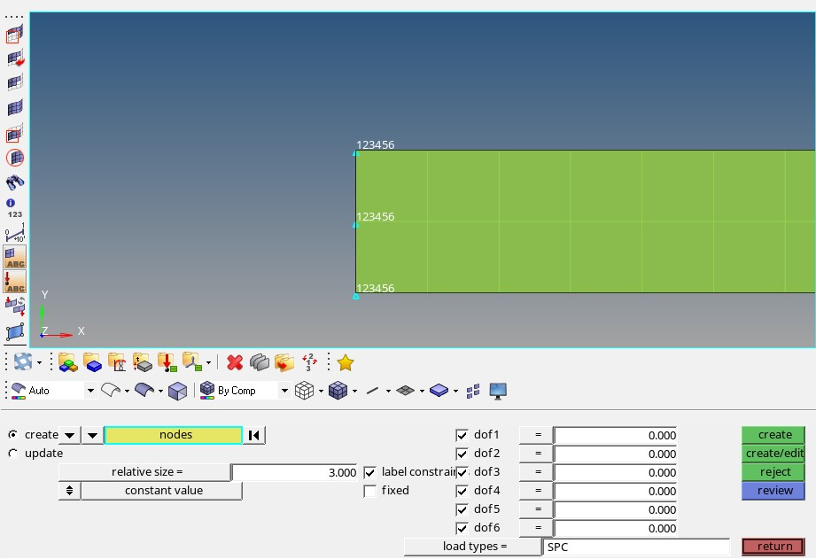
Boundary conditions
In the analysis section there is the possibility to set the boundary conditions of the system examined
Magnitude of the load and direction (cartesian axis)
It is possible to define how many dofs have to be set to 0

Slide 4
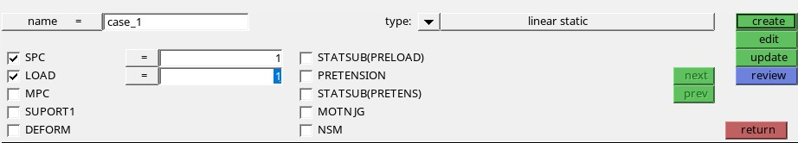
Loadstep
The loadstep is the definition of boundary condition which we want to apply in our simulation; it is possible to create more than one loadstep in order to simulate different situation on the same model, changing type or magnitude of load or constraints.
SPC: level that has to be used for constraints indicated by the ID number (where we have defined the constraints we want)
LOAD: level that has to be used for loads indicated by the ID number (SPC and LOAD levels could be the same)

Slide 5
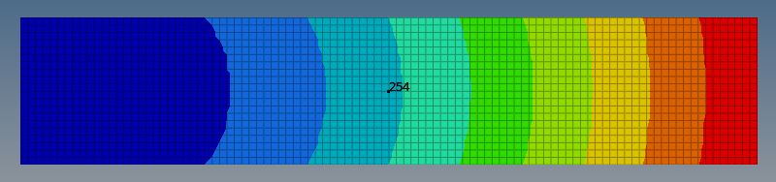
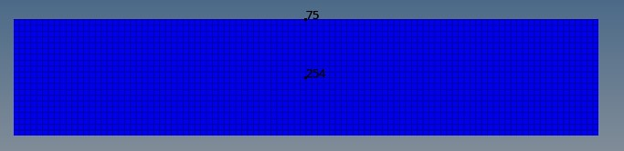
Solution convergence
The evaluation of numerical result has to be done in a cross section far from the points of application of the boundary conditions, in order to avoid local influence on the stress and displacement state
Central node taken to evaluate the displacement
Node taken for the evaluation of the shear strees (τ_{xy})
Node taken for the evaluation of the axial stress (σ_{xx})

Slide 6



Results
Element type
n° of nodes
f
$$σ_{max}$$
$$τ_{max}$$
Theoretical | - | 0,1517 | 150 | 15
 |  | mm | MPa | MPa
4 nodes | 1x4 | 0,1541 | 6,64E-13 | 10
 | 2x8 | 0,1547 | 74,995 | 10
 | 4x16 | 0,1567 | 112,5 | 13,6
 | 6x20 | 0,1572 | 125 | 14,38
 | 8x32 | 0,1576 | 131,2 | 14,65
 | 16x64 | 0,1579 | 140,6 | 14,91
 | 20x100 | 0,1579 | 142,5 | 14,94
3 nodes | 1x4 | 0,03416 | 12,86 | 8,705
 | 2x8 | 0,07765 | 49,38 | 9,277
 | 4x16 | 0,1242 | 98,29 | 12,58
 | 6x20 | 0,1377 | 116,1 | 13,63
 | 8x32 | 0,1476 | 128,4 | 14,28
 | 16x64 | 0,1552 | 141,1 | 14,81
 | 20x100 | 0,1564 | 143,5 | 14,89
Theoretical value :
$$𝒻=\frac{5∙F∙L^{3}}{48∙E∙J_{z}}$$
$$σ_{max}=\frac{3∙F∙l}{t∙h^{2}}$$
$$τ_{max}=\frac{3∙F}{2∙t∙h}$$
Analysis is about convergence to a different value, not the critical one

Slide 7
Influence of boundary condition
The analysis is now performed changing the application of the boundary conditions: both constraints and load can be applied in 2 different ways, so we end up with 4 cases:
Constraints:
Horizontal displacement constrained for all nodes to zero and vertical one just for the middle node (case 1)
All nodes with horizontal and vertical displacement constrained to zero (case 2)
Loads:
Single vertical force applied on the middle of the right side of the beam (case A)
Distributed load, vertical force equally divided and applied on each node of the righten edge (case B)

Slide 8
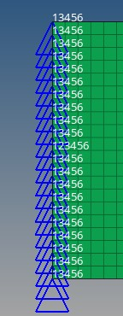
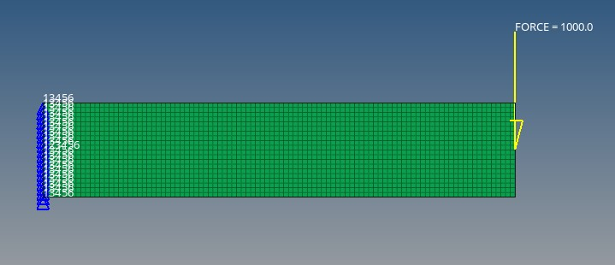
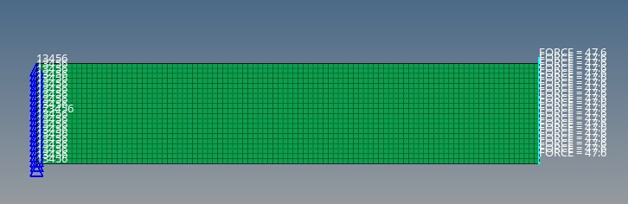
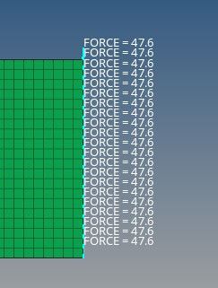
Boundary condition, Constraints:
Horizontal displacement constrained for all nodes to zero and vertical one just for the middle node (case 1)
Loads:
Single vertical force applied on the middle of the right side of the beam (case A)
Distributed load, vertical force equally divided and applied on each node of the righten edge
(case B)
Case 1A
Only the node in the middle with all dofs to 0, in the other «5» is missing
Case 1B
Load is equally distributed on each node

Slide 9
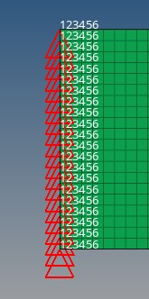
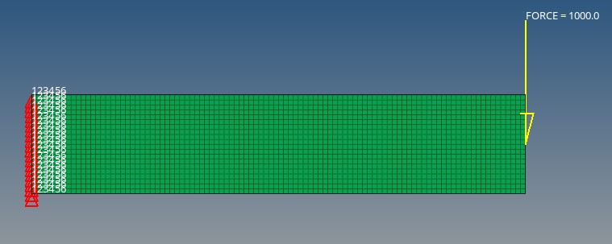
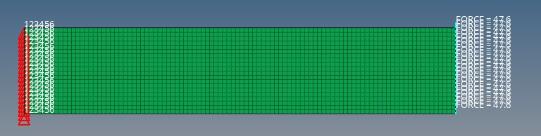
Boundary condition, Constraints:
All nodes with horizontal and vertical displacement constrained to zero (case 2)
Loads:
Single vertical force applied on the middle of the right side of the beam (case A)
Distributed load, vertical force equally divided and applied on each node of the righten edge
(case B)
Case 2A
All nodes with all dofs constrained, which corresponds to set all of them to 0
Case 2B
All nodes’ dofs constrained and equally distributed loads on the nodes

Slide 10
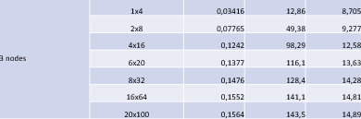
Graphical data representation
TRIA elements

Slide 11
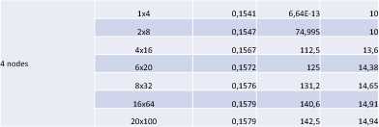
QUAD elements

Slide 12
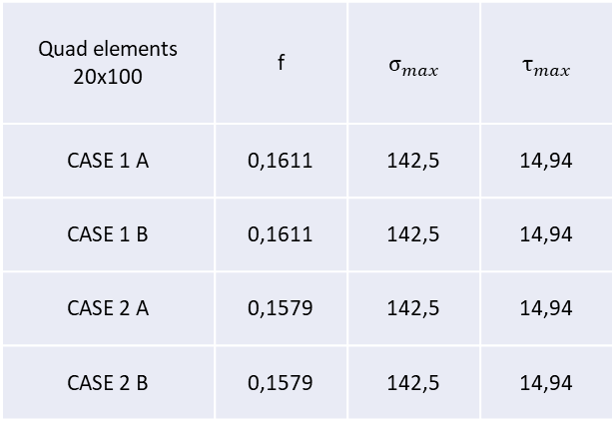
Analysis of the results
As expected from the theory, increasing the number of nodes of the mesh the accuracy of the analysis increases, more or less exponentially, to the theoretical value
Considering the convergence of the displacement it is possible to see that it tends to a value a bit higher from the theoretical one, which can be due to a deformation induced by the shear as it is explaied in the theory of elasticity by Timoshenko beam theory
From the collected data is clear that the QUAD elements reults to approximates better the shear stress, while the TRIA elements approximates better the normal stress
Quad elements 20x100 | f | $$σ_{max}$$ | $$τ_{max}$$
CASE 1 A | 0,1611 | 142,5 | 14,94
CASE 1 B | 0,1611 | 142,5 | 14,94
CASE 2 A | 0,1579 | 142,5 | 14,94
CASE 2 B | 0,1579 | 142,5 | 14,94
There is no change in the analyical data, both for displacement and stresses. (loading condition)
In the group 1 there is an increase only in the displacement, maybe due to an infinitesimal rotation of the left edge, due to the free horizontal displacement of its nodes but for central one (variation of the constraints)

